Slide 1
CSCE 1035 Computer Programming I Chapter 5 Loops
University of North Texas

Slide 2

5.1 Loops (General)

Slide 3

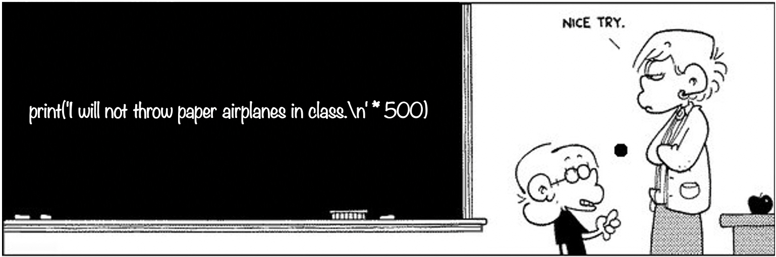
Motivation for Loops
What should you do if a teacher asked you to write 500 times "I will not throw paper airplanes in class"?
I will not throw paper airplanes in class.
I will not throw paper airplanes in class.
I will not throw paper airplanes in class.
I will not throw paper airplanes in class.
…
… or what about the following?
count = 1
while count <= 500:
print('I will not throw paper airplanes in class.')
count = count + 1

Slide 4
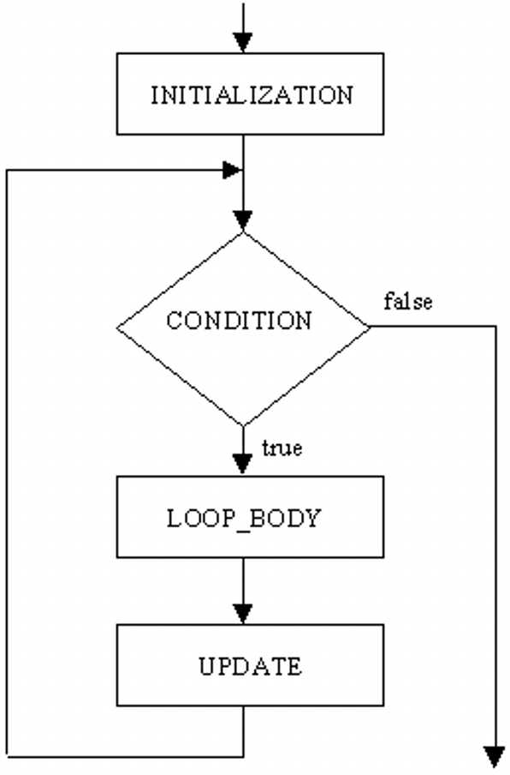
Loop Basics
When an action must be repeated, a loop can be used
A loop is a program construct that repeats a statement or sequence of statements a number of times
The body of the loop is the statement or statements that are repeated
Each repetition of the loop is an iteration
Loop design questions
What should be included in the loop body?
How many times should the loop be iterated?
Pythons supports several loops
We can use a while loop or a for loop

Slide 5
5.2 While Loops

Slide 6
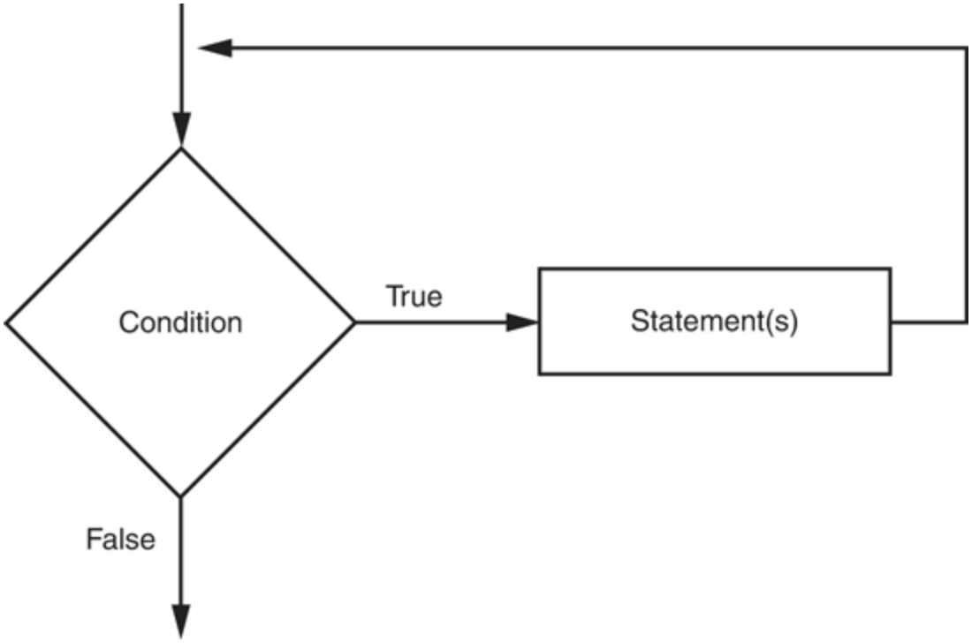
while Loop Syntax
A while loop is a condition-controlled loop
A condition-controlled loop causes a statement or set of statements to repeat as long as a condition is true
Loop body can include one or more statements to be executed if condition is true
General Format
while condition:
loop body
additional statements
The while loop is a pretest loop, meaning that the condition will be tested before performing an iteration
The logic of a while loop

Slide 7
while Loop Template
Example
count_down = 6
while count_down > 0:
print('Hello')
count_down = count_down - 2
print('done')
If condition is true, indented code in while block runs
At end of while block, control automatically goes back to while condition line
Initialization Action
Boolean Expression
Update Action
while Block
This process continues indefinitely until while condition is false

Slide 8
Sentinel Loops
A sentinel loop continues to process data until reaching a special value that signals the end
This special value is called a sentinel, which must be distinguishable from the data since it is not processed as part of the data
General format (not syntax)
get the first data item
while item is not the sentinel process the item get the next data item
The first item is retrieved before the loop starts
Called the priming read, since it gets the process started
If first item is the sentinel, the loop terminates with no data processed
Otherwise, the item is processed and the next one is read

Slide 9
Infinite Loops
Loops that never stop are infinite loops
Would have to send an interrupt (i.e., Ctrl-C) to end the program
Loop body should contain a line that will eventually cause the Boolean expression to become false (i.e., update condition)
Example:
Print the odd numbers less than 12
x = 1
while x != 12:
print(x)
x = x + 2
print('done')
Better to use the comparison while x < 12:

Slide 10
5.3 More While Examples

Slide 11
docstrings
Strings at the top of module files (and the top of functions and classes) become "docstrings", which are automatically inserted into the __doc__ attribute of the object
Can use single or double quotes to delimit the string
print(__doc__)
Can print the docstrings for built-in Python objects
>>> import sys
>>> print(sys.__doc__)
PyDoc is a tool that can extract the docstrings and display them, either via the help command or via a GUI/HTML interface
>>> help(list)

Slide 12
Random Numbers
Random numbers are useful in a lot of programming tasks
Python supports a random number generator
import random
The randint() function generates a random integer in the range [min, max], inclusive
randint(min, max)
The choice() function returns a randomly chosen value from the given sequence, which can be a range, a string, a list, etc.
>>> import random
>>> random.choice(range(4, 20, 2))
14
>>> from random import choice
>>> choice("hello")
'l'
Can use a different seed with random.seed() in order to get different series of random numbers

Slide 13
5.4 Counting

Slide 14
Counters
Often when creating and using while loops, we need to keep count of how many times the loop has executed
Usually used as the test condition for a while loop
Example
count = 1
while count < 10:
print('Hello')
count = count +1
In this simple example, count is referred to as the counter
Other forms of counting
Count down
Count by 2’s
…

Slide 15
5.5 For Loops

Slide 16
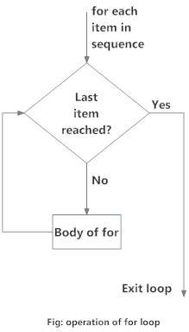

for Loop Syntax
A for loop is a count-controlled loop that iterates a specific number of times through a sequence of values
General Format
for item in container:
loop body
additional statements
A for loop statement loops over each element in a container, one at a time
Container can be a list, a tuple, a string, etc.
The loop index item takes on each successive value in the sequence
The statements in the body of the loop are executed once for each value
The operation of a for loop

Slide 17
for Loop Iterations
A for loop steps through each of the items in a container, or any other type of object that is iterable
If container is a list or a tuple, then loop steps through each element of the sequence
>>> fruits = ['banana', 'apple', 'mango']
>>> for fruit in fruits:
... print('Current fruit:', fruit)
...
Current fruit: banana
Current fruit: apple
Current fruit: mango
If the container is a string, then the loop steps through each character of the string
for some_char in "Hello World":
print(some_char)

Slide 18
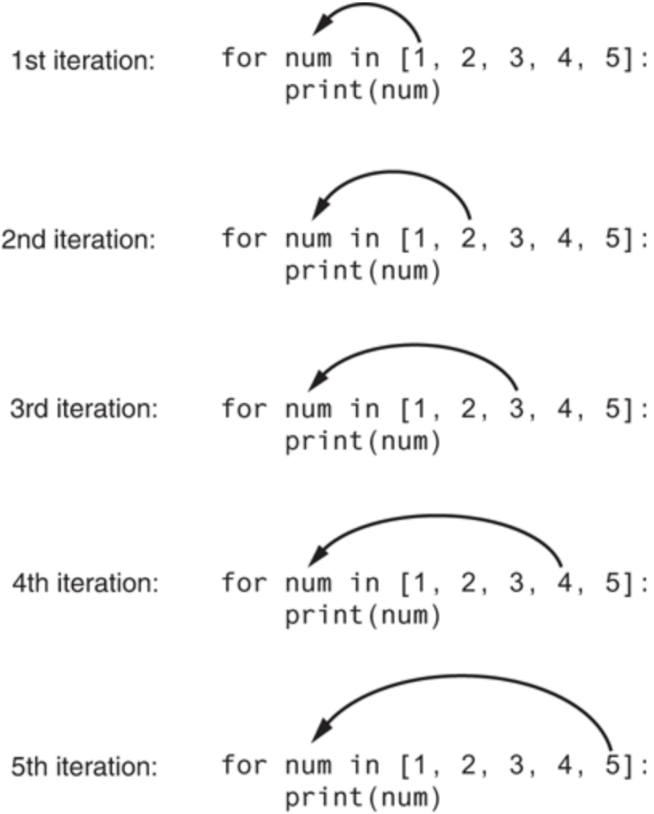
for Loop Example
>>> for num in [1, 2, 3, 4, 5]:
... print(num)
...
1
2
3
4
5
Can also iterate backwards over a sequence
list1 = [1, 2, 3, 4, 5]
for num in reversed(list1):
print(num)

Slide 19
for Loop Iterations
The item, or target variable, in the for loop can be more than a single variable name
When the container elements are themselves sequences, then the item can match the structure of the elements
This multiple assignment can make it easier to access the individual parts of each element
>>> for (x, y) in [('a', 1), ('b', 2), ('c', 3), ('d', 4)]:
... print(x)
... if x == 'b':
... print(x * y)
...
a
b
bb
c
d
Using a for loop to iterate over a dictionary
ages = {"Sam": 4, "Mary": 3, "Bill": 2}
for name in ages.keys():
print(name, ages[name])

Slide 20
5.6 Counting Using the Range() Function

Slide 21
The range Function
The range function creates an iterable list of values
range([start,] stop[, step])
Repeats for values start (inclusive) to stop (exclusive)
Default start value is 0, step value is 1
Provides a range of iterable values
Counting forward
range(10, 20)
Counting backward
range(20, 10, -1)
Counting by different amounts
range(0, 50, 5)

Slide 22
for Loops with range() Examples
>>> for x in range(1, 6):
... print(x, 'squared is', x * x)
...
1 squared is 1
2 squared is 4
3 squared is 9
4 squared is 16
5 squared is 25
How would we print every second element in a list?
>>> data = [8, 23, 18, 14, 20, 5, 8]
>>> for i in range(0, len(data), 2):
... print(data[i])
...
8
18
20
8

Slide 23
5.7 While vs. For Loops

Slide 24
Choosing a Loop
As a general rule
Use a for loop when number of iterations is computable before entering the loop
E.g., counting down from N to 0, printing results N times, etc.
Use a for loop when accessing the elements of a container
e.g., adding 1 to every element in list, printing the key of every entry in a dictionary, etc.
Use a while loop when the number of iterations is not computable before entering the loop
E.g., iterating until a user enters a sentinel value, etc.

Slide 25
5.8 Nested Loops

Slide 26
Nested Loops
The body of a loop may contain any type of statement, including another loop
A nested loop is simply a loop contained inside another loop
When loops are nested, all iterations of the inner loop are executed for each iteration of the outer loop
Can mix-and-match between while loops and for loops
Total number of iterations in a nested loop
number_iterations_inner x number_iterations_outer
for item in container:
while condition:
statement(s)
statements
Outer Loop
Inner Loop

Slide 27
Nested Loop Example
>>> list_of_lists = [['hammerhead', 'great white', 'dogfish'], \
... [0, 1, 2], [9.9, 8.8, 7.7]]
>>> for list in list_of_lists:
... print(list)
...
['hammerhead', 'great white', 'dogfish']
[0, 1, 2]
[9.9, 8.8, 7.7]
>>> for list in list_of_lists:
... for item in list:
... print(item)
...
hammerhead
great white
dogfish
0
1
2
9.9
8.8
7.7
When just one for loop is used, the program will output each internal list as an item
When we utilize a nested for loop, we are able to iterate over the individual items contained in the lists

Slide 28
5.9 Developing Programs Incrementally

Slide 29
Common Loop Errors
Off-by-one errors, where the loop executes one too many or one too few times
Check your comparison if should be < or <=
Check that the initialization uses the correct value
Does the loop handle the zero iterations case?
Step through the loop with changing variables
print() statements can be used to trace a value
Infinite loops usually result from an error in the condition that controls the loop
Check the direction of inequalities whether it should be < or >
Test for < or > rather than equality ==
Recall that a float is really only an approximation

Slide 30
Incremental Development
Goal of incremental development is to avoid debugging large, complex programs
Instead, incrementally write code and then test it periodically to ensure each new part works as expected
Benefits include that errors are easier to isolate, find, and fix

Slide 31
5.10 Break and Continue

Slide 32
break and continue Statements
The break statement terminates the current loop and transfers execution at the next statement following that loop
The most common use for break is when some external condition is triggered that requires an exit from a loop
The continue statement skips all the remaining statements in the current iteration of the loop and moves control back to the top of the loop
The continue statement will cause program to immediately retest its condition prior to the next iteration
Both the break and continue statements can be used in both while and for loops
The pass statement is used when a statement is required syntactically, but you do not want any code to execute

Slide 33
break and continue Statements
number = 30
while number >= 0:
print(number, "", end='')
if number < 15:
break
number -= 5
print('done')
This iteration is over and there are no more iterations
number = 30
while number >= 0:
number -= 5
if number < 15:
continue
print(number, "", end='')
print('done')
This iteration is over; do the next iteration

Slide 34
5.11 Loop Else

Slide 35
break and continue Statements
A loop may optionally include an else clause that executes only if the loop terminates normally (i.e., not using break)
If used with a for loop, the else statement is executed when the loop has exhausted iterating the list
If used with a while loop, the else statement is executed when the condition becomes false
General Format
while condition:
loop body
else:
else body
additional statements
General Format
for item in container:
loop body
else:
else body
additional statements

Slide 36
5.12 Getting Both Index and Value When Looping: Enumerate()

Slide 37
break and continue Statements
The enumerate() function can be used to retrieve the position index and values in a sequence
>>> # tell users where odd numbers are
>>> list = [5, 7, 4, 2, 3, 8, 1]
>>> for index, value in enumerate(list):
... if value % 2 == 1:
... print('odd number', value, 'at position', index)
...
odd number 5 at position 0
odd number 7 at position 1
odd number 3 at position 4
odd number 1 at position 6

